Slide 1
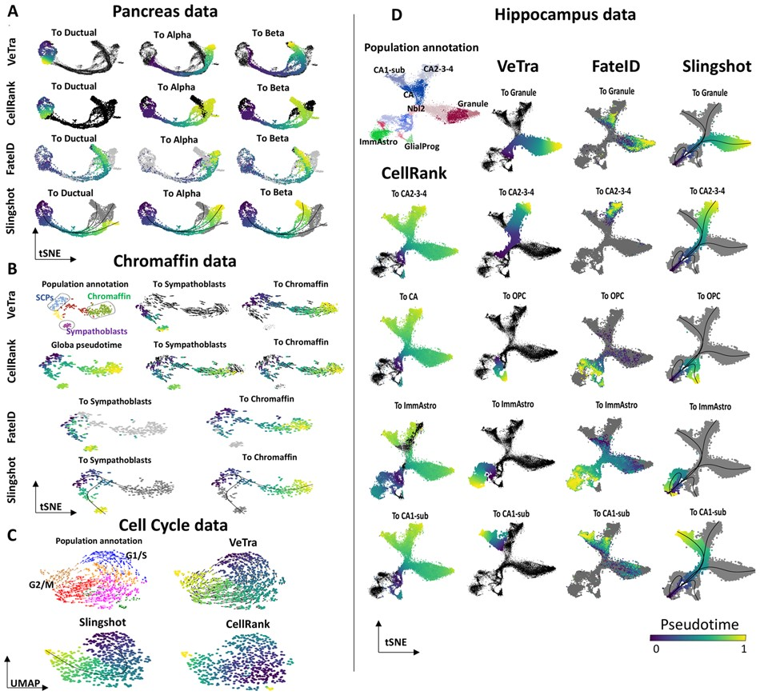

Fig. 2. Performance assessment of the TI tools using the scRNAseq datasets with various topologies. The trajectories ...
Notes:
Fig. 2. Performance assessment of the TI tools using the scRNAseq datasets with various topologies. The trajectories inferred by VeTra, CellRank, FateID and Slingshot using the scRNAseq data for (A) pancreatic development, (B) chromaffin and sympathoblasts development, (C) cell cycle and (D) hippocampus development
Unless provided in the caption above, the following copyright applies to the content of this slide: © The Author(s) 2021. Published by Oxford University Press.This is an Open Access article distributed under the terms of the Creative Commons Attribution Non-Commercial License (https://creativecommons.org/licenses/by-nc/4.0/), which permits non-commercial re-use, distribution, and reproduction in any medium, provided the original work is properly cited. For commercial re-use, please contact journals.permissions@oup.com

